Slide 1
Spring MVC
Fundamentals

Slide 2
Agenda
What is Spring MVC?
Model
View
Controller
Controller Arguments
Controller Return Types
Lifecycle

Slide 3
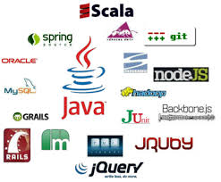
What is Spring MVC

Slide 4
What is Spring MVC?
The Spring Web model-view-controller (MVC) framework is designed around a DispatcherServlet that dispatches requests to handlers, with configurable handler mappings, view resolution, locale, time zone and theme resolution as well as support for uploading files.

Slide 5
Principle followed by Spring MVC
"Open for extension…" A key design principle in Spring Web MVC and in Spring in general is the "Open for extension, closed for modification" principle.
Some methods in the core classes of Spring Web MVC are marked final. As a developer you cannot override these methods to supply your own behavior. This has not been done arbitrarily, but specifically with this principle in mind.

Slide 6
Model
Map<String, Object>
Populated by controllers
Contains all data needed by the view
Not containing business logic
Examples:
model.addAttribute(“orders”,orderService.getDailyOrders(user));
Model.addAttribute(“period”,Period.DAILY);

Slide 7
View
HTML, XML, RSS, PDF, etc
JSP, Freemarker, Velocity, etc.
Direct access to the model
Example:
<span>${latestOrder.date}<span>
<input type=“text” value=“${order.name}”/>

Slide 8
Controller
Gathers input parameters and coordinates the back-end process
Front Controller VS Controller
@Controller
Resful URL, request-process-forward, @RequestMapping
Method=Action
Unit Test Friendly
Pluggable mechanism for argument resolution

Slide 9
Controller Arguments
@RequestParam, @PathVariable
POJO – arbitrary java object that gets populated with request values
@Valid – to enforce validation of the POJO
BindingResult – to access the results of binding and validation
Model, ModelMap, Map<String,?> -- access to the model object
Raw HttpServletRequest, response, session
Locale, @RequestHeader, @RequestBody

Slide 10
Controller Return Types
String
View
ModelAndView
@ResponseBody

Slide 11
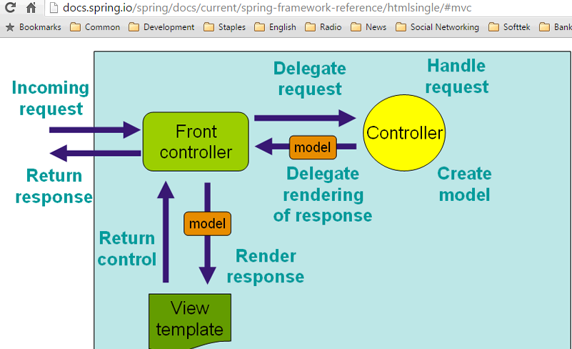
Lifecycle

Slide 12
Demos

Slide 13
spring-mvc-xml-helloworld
spring-mvc-showcase

Slide 14
Resources

Slide 15
https://github.com/JavaAcademy/Spring-Framework/tree/master/Spring-MVC
http://docs.spring.io/spring/docs/current/spring-framework-reference/htmlsingle/
http://es.slideshare.net/rapaul/introduction-to-spring-mvc

Slide 17
Rene Valladares
Rene.valladares@softtek.com
Related to training material (Spring Security module)
XXX XXXX
XXXX.XXXX@softtek.com
Instructor

